Slide 1
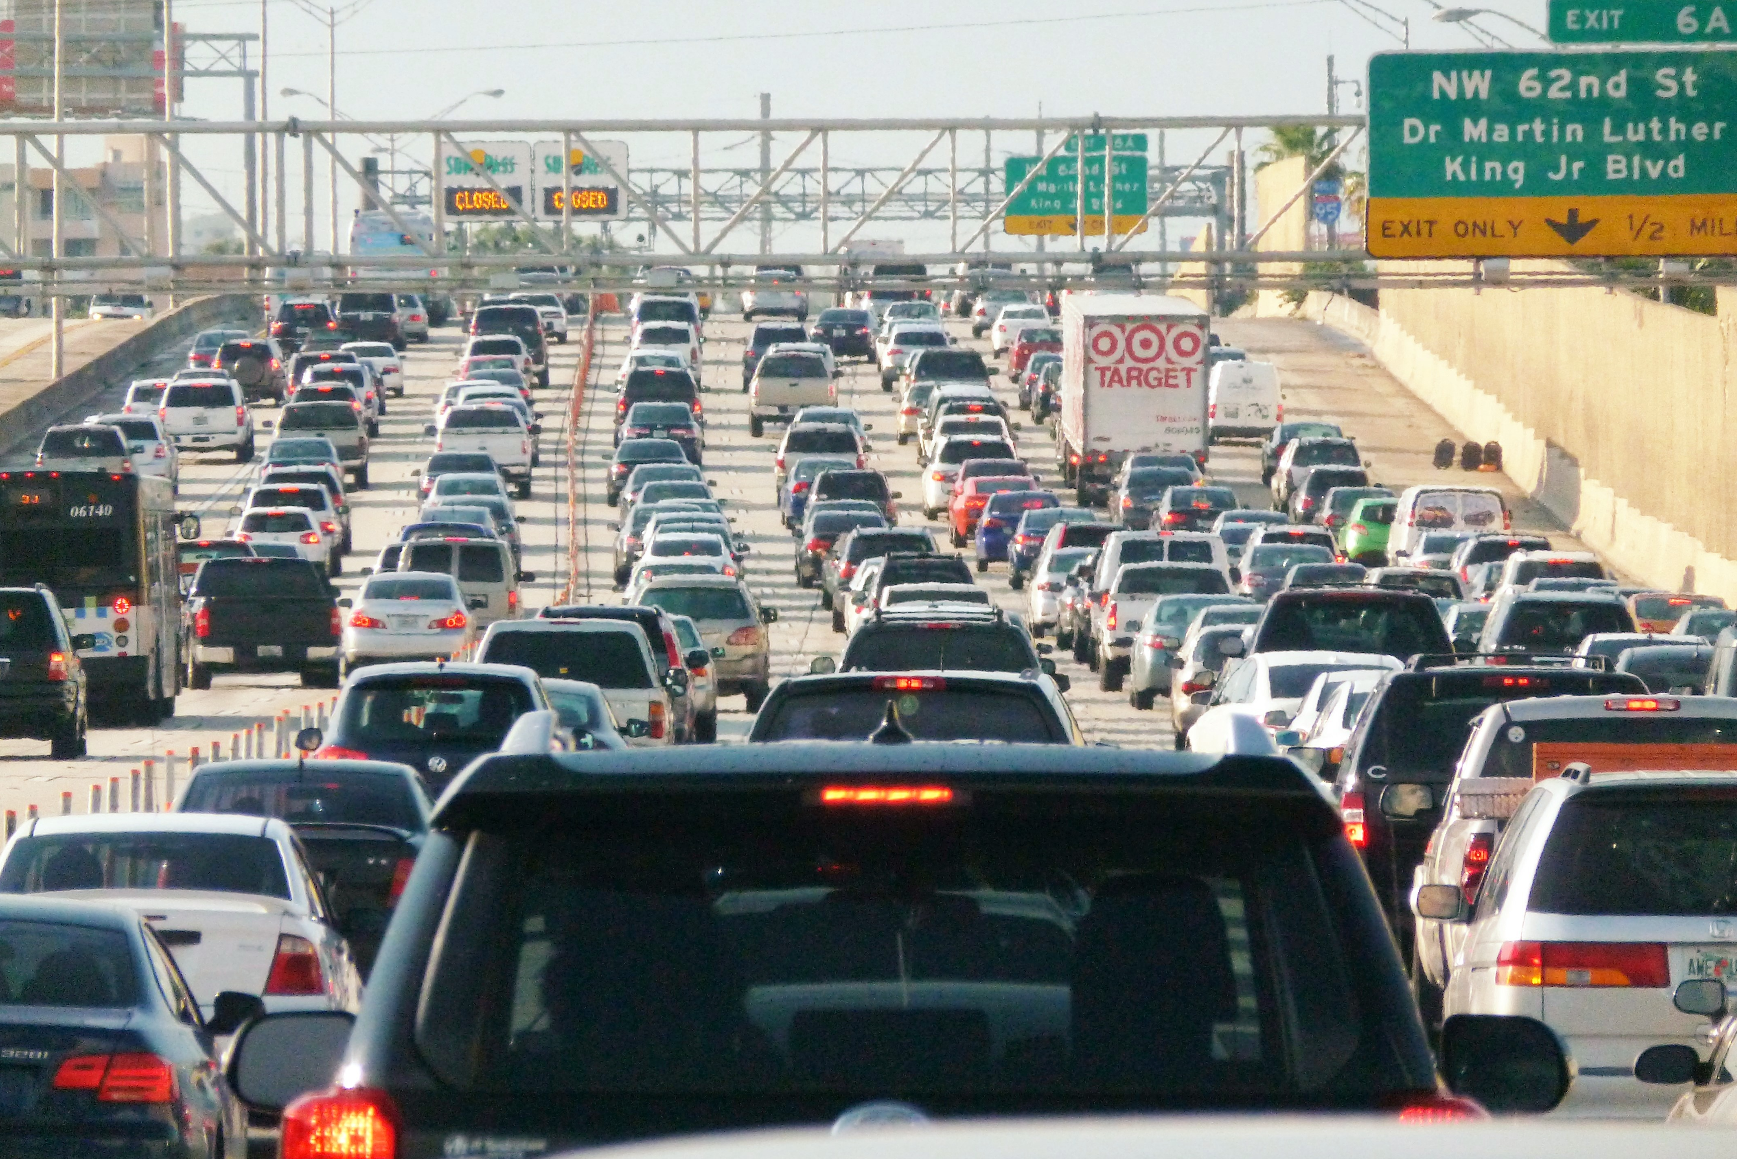
How can traffic be improved in Miami?

Slide 2
Major Problems
Poor public transportation
Cars are more of a necessity than an option
Inadequate lanes and construction
Highways are too small for the amount of population
Closed off lanes due to construction projects
Unhelpful traffic lights
No consistent lights strategy

Slide 3
The Process
First approach: Covering Initial Hypotheses individually
Problem: A lot of this specific Information is through websites/videos available, but not through data files for analysis
Very hard to find useful specific data
Adjustment of the scope
Linear Regression: Issues in R
“vector memory exhausted (limit reached?)”
Linear regression in python instead of R

Slide 4
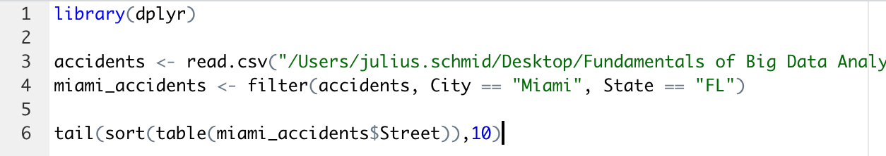
Miami Streets with most accidents
Dataset: CSV file with US accidents between 2016 and 2021
https://www.kaggle.com/datasets/sobhanmoosavi/us-accidents
Data Preparation:
Filter the accidents for Miami, FL
Return the streets with most accidents

Slide 5
Miami Streets with most accidents
Ranking | Street | Number of Accidents
#1 | I-95 N | 3267
#2 | I-95 S | 3210
#3 | SW 137th Ave | 1118
#4 | Palmetto Expy N | 1041
#5 | Dolphin Expy E | 1020
#6 | S Dixie Hwy | 993
#7 | Palmetto Expy S | 968
#8 | SW 88th St | 886
#9 | Florida's Tpke S | 862
#10 | Dolphin Expy W | 679

Slide 6
Public Transportation: Analysis
Dataset: CSV file about Metro Interstate Traffic Volume
https://www.kaggle.com/code/ramyahr/metro-interstate-traffic-volume/notebook
traffic volume for westbound I-94, Minneapolis-St Paul, MN
Hourly collected data, ranging from 2012 until 2018
Contains weather data as temperature (K), clouds, rainfall and snowfall
First Consideration: Influence of Time
Second Consideration: Regression approach including weather data

Slide 7
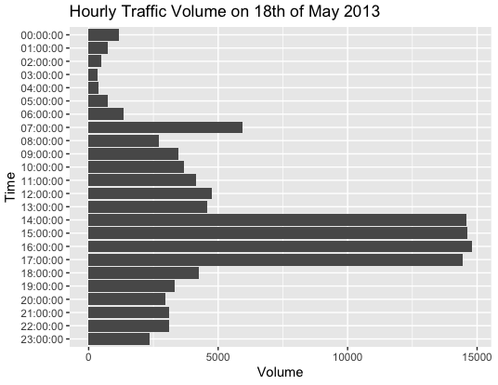
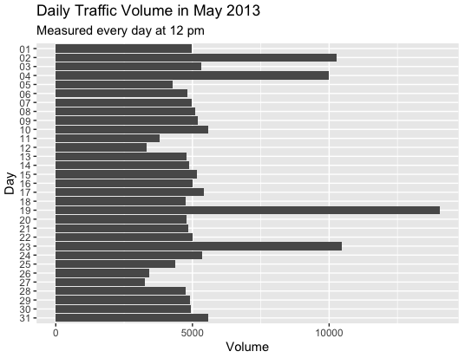
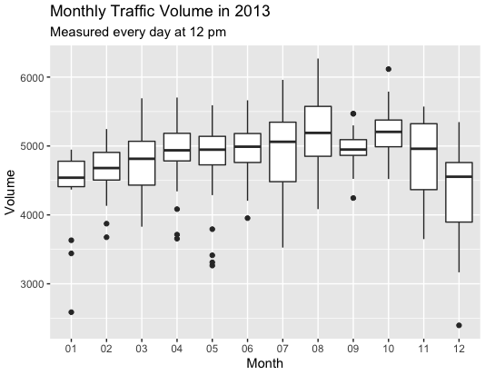
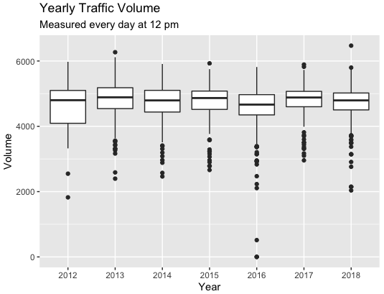
Public Transportation: Time Influence

Slide 8
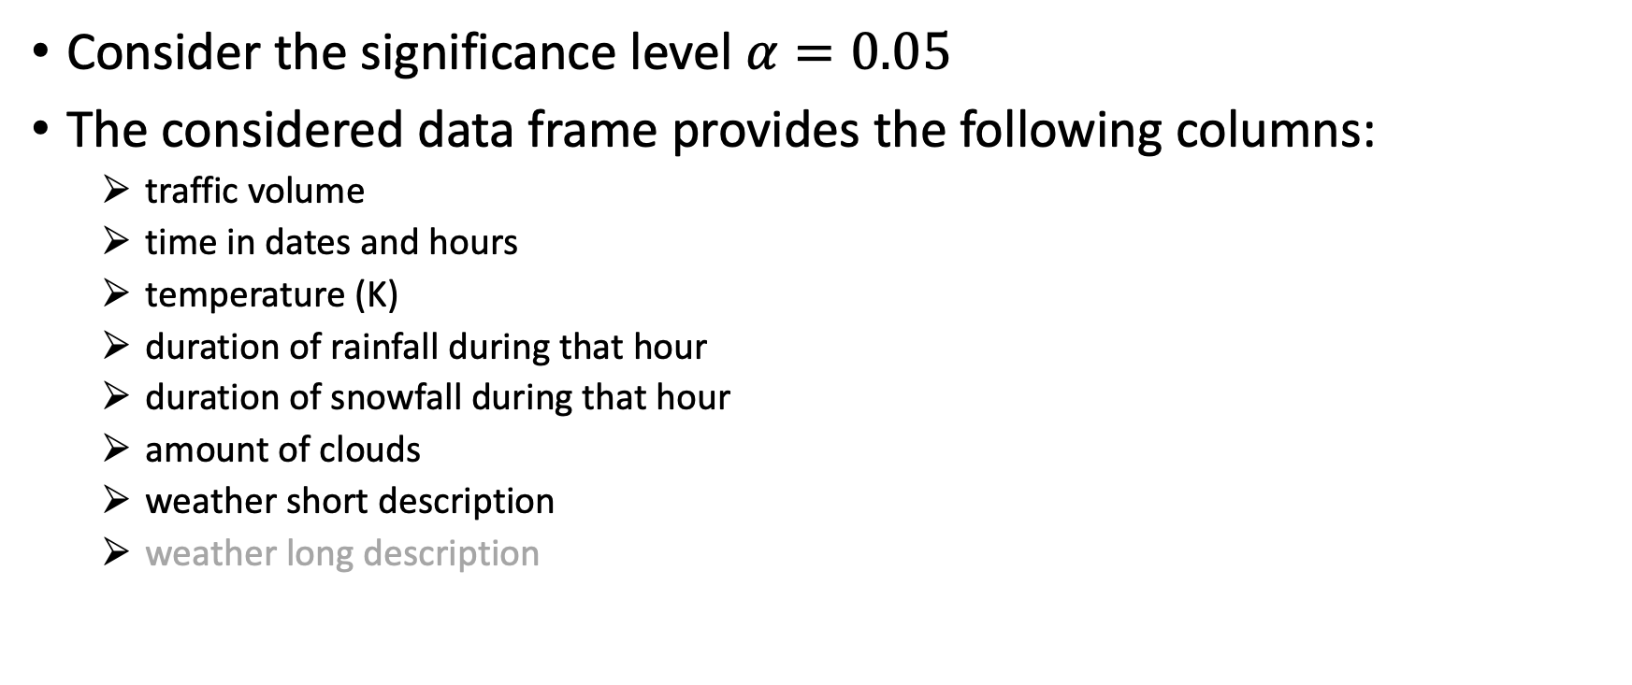
Regression: Predicting PT Traveler Volume
Consider the significance level $α=0.05$
The considered data frame provides the following columns:
traffic volume
time in dates and hours
temperature (K)
duration of rainfall during that hour
duration of snowfall during that hour
amount of clouds
weather short description
weather long description

Slide 9
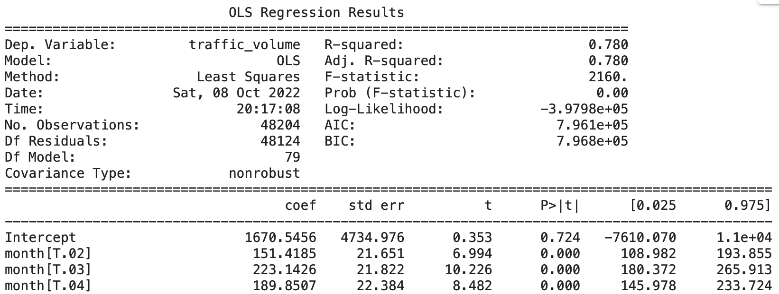
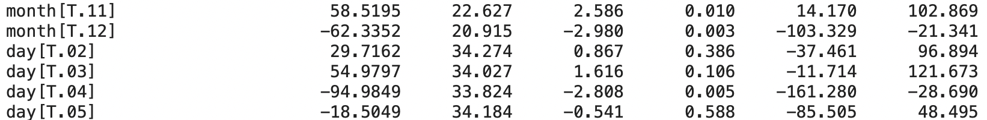
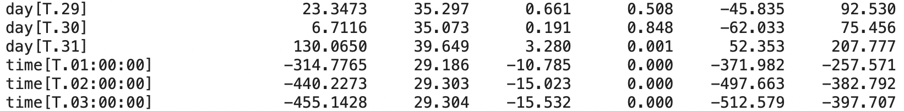
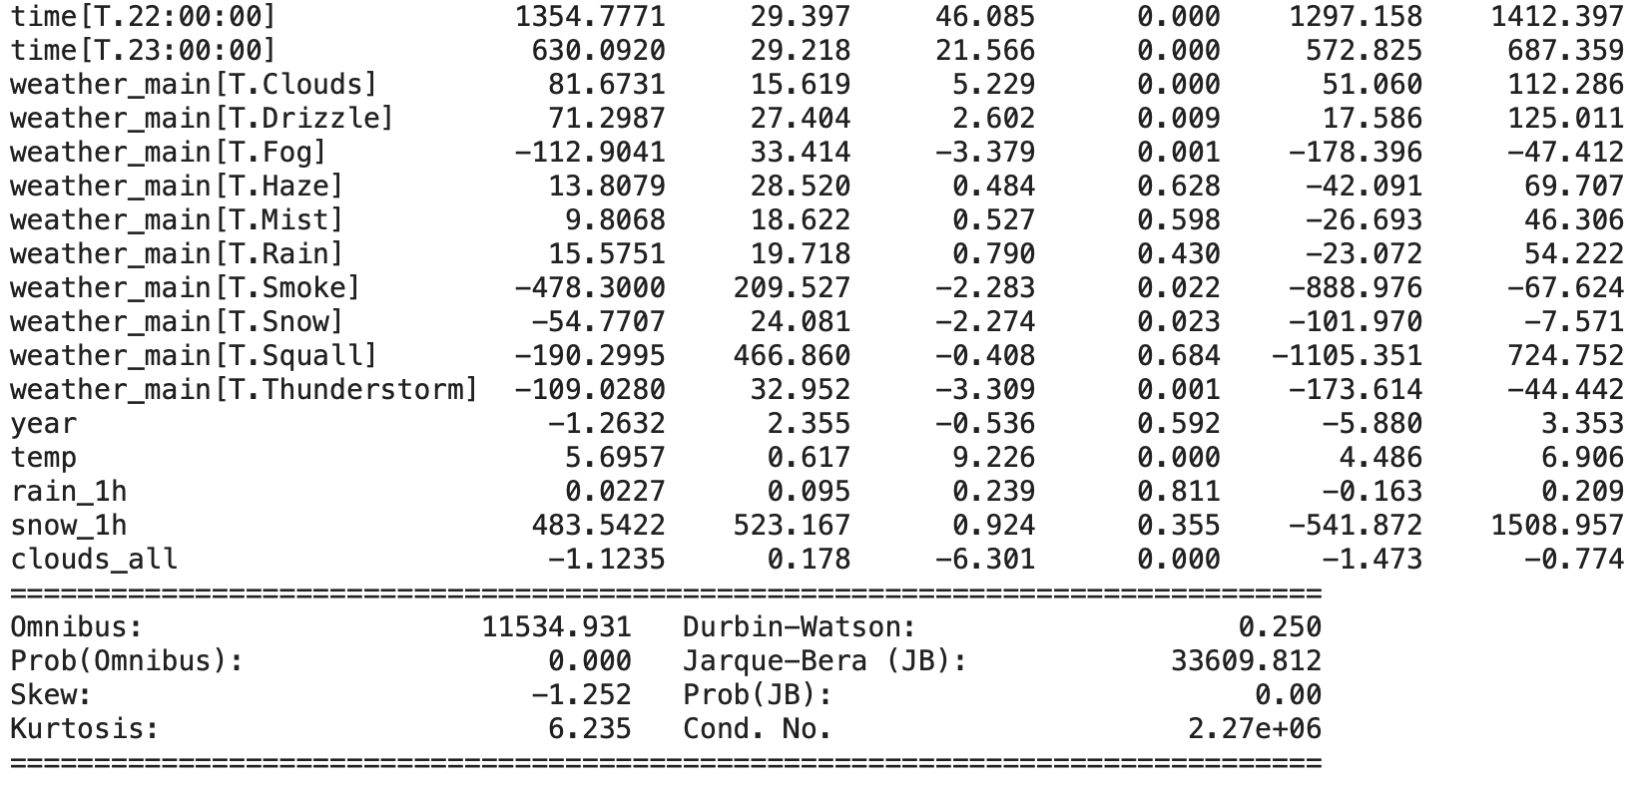
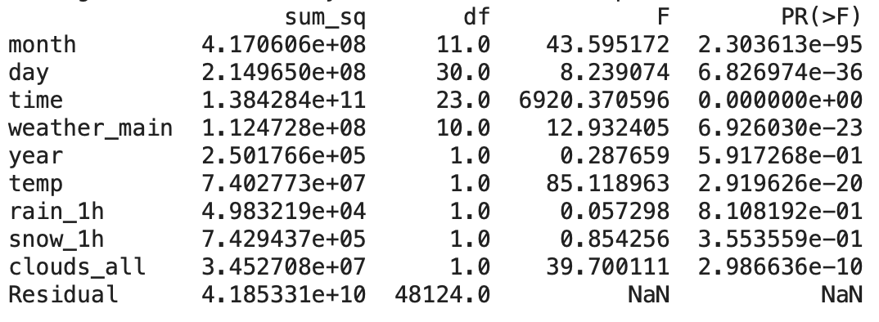
First approach: Using all available parameters
Traffic volume = $a_{0} \text{+} a_{1}$ * year + … + $a_{9} ∗$ weather (short description)

Slide 10
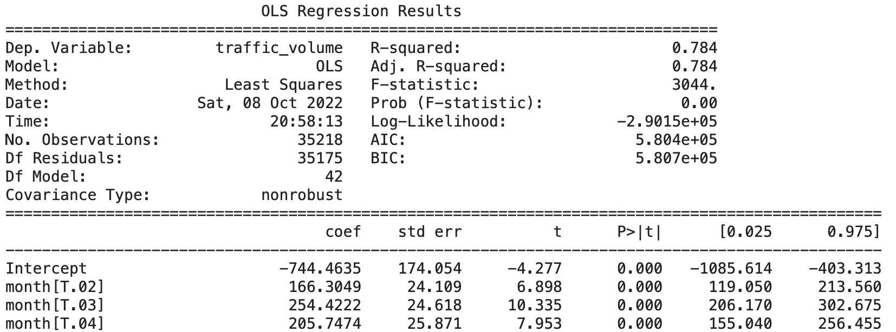
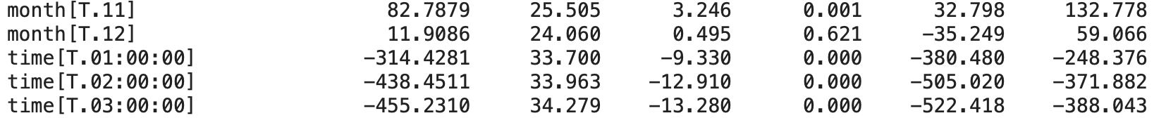
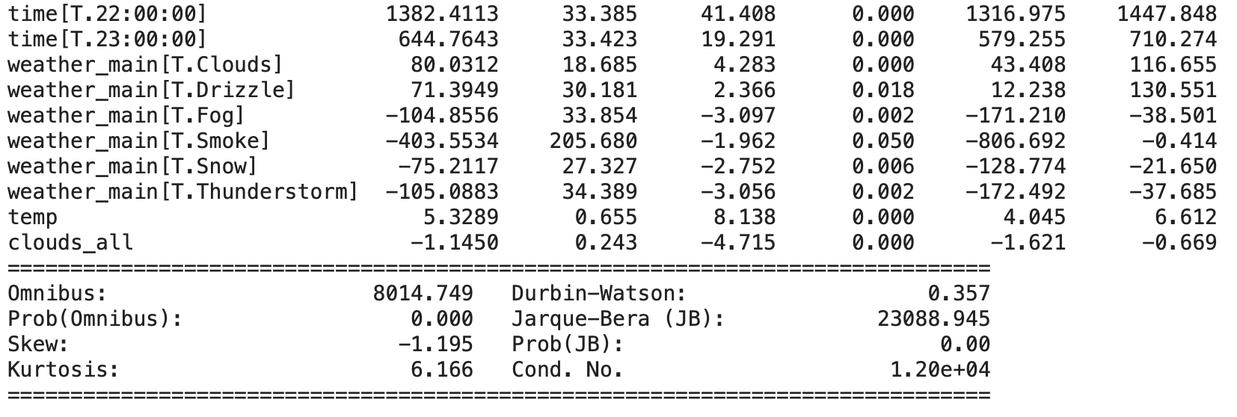
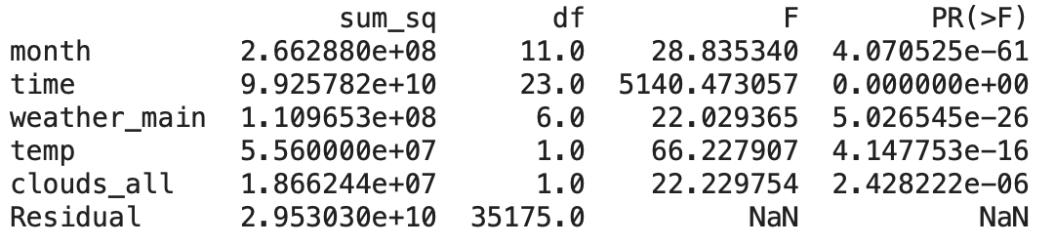

Second approach: Refine the model
Eliminate all parameters with p-value > 0.05
Day
Weather partially (haze, mist, rain and squall)
Year
Rain_1h
Snow_1h
Traffic volume
= $a_{0} \text{+} a_{1}$ * month + … + $a_{5} ∗$ weather (short description)*

Slide 11
Sources
https://www.kaggle.com/datasets/sobhanmoosavi/us-accidents
https://www.kaggle.com/code/ramyahr/metro-interstate-traffic-volume/notebook

Slide 12
Backup

Slide 13
Contents
Framework
Major Problems
Possible Solutions
Hypotheses Analysis
Conclusion
Sources

Slide 14
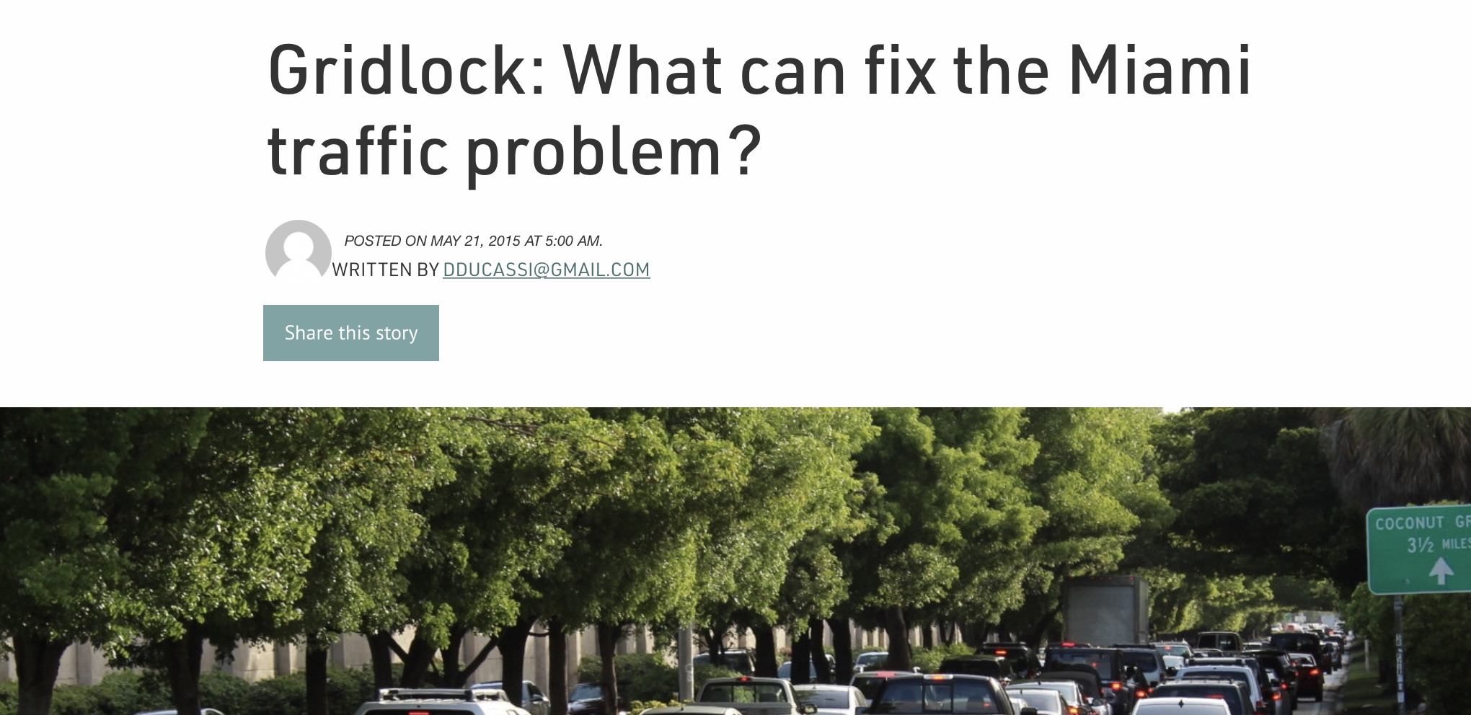

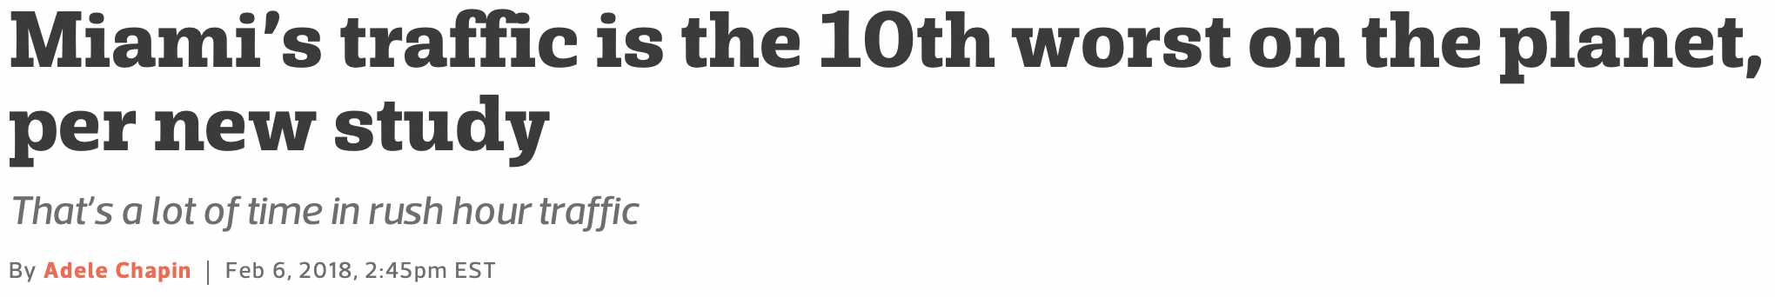

1. Framework
Miami is listed 3rd in a ranking of US cities with the worst traffic (https://www.fox13news.com/news/us-cities-with-the-worst- traffic-congestion)
According to the FoxNews article, drivers spent an extra 4 days and 10 hours in rush hour traffic
Type of data: mostly unstructured

Slide 15
2. Major Problems
Poor public transportation
Cars are more of a necessity than an option
Inadequate lanes and construction
Highways are too small for the amount of population
Closed off lanes due to construction projects
Unhelpful traffic lights
No consistent lights strategy

Slide 16
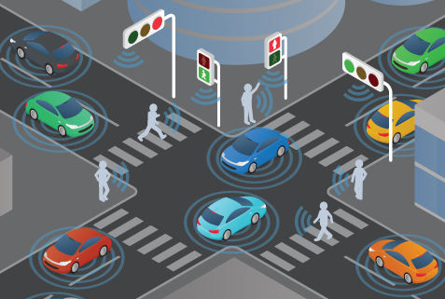
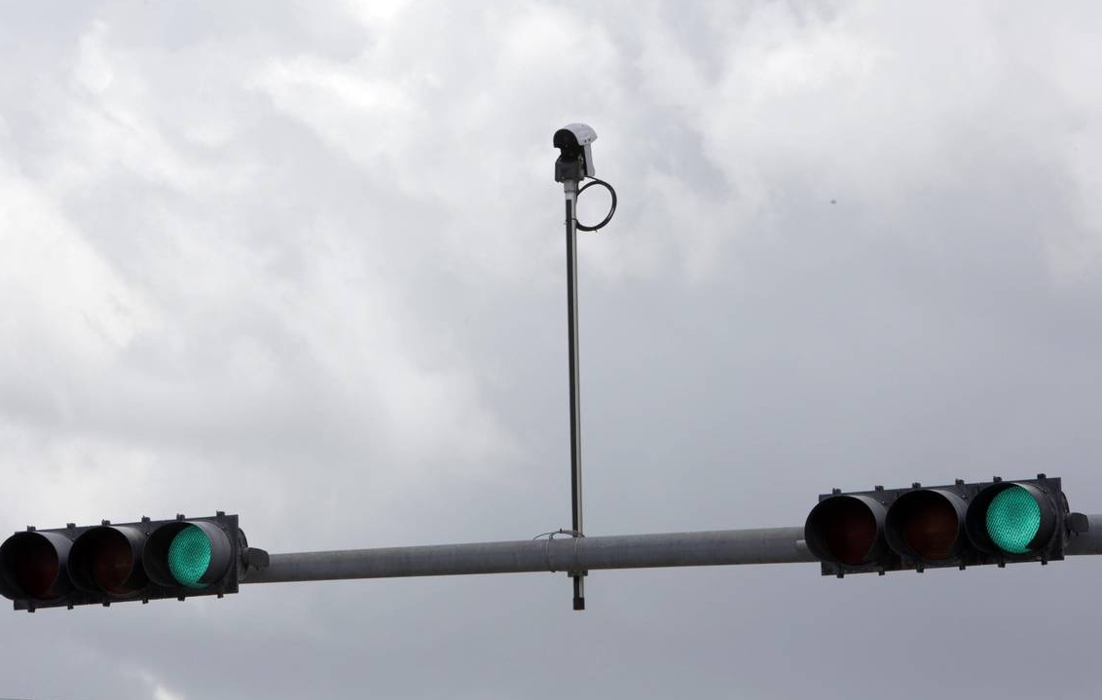
Hypothesis: Miami’s traffic can be improved by introducing smart traffic lights
adaptive traffic lights that rapidly adjust signal timing according to traffic conditions and speeds
Up until now, 340 smart signals have been placed across the county, of which about 16 have been located in Doral along 36th Street from 72nd Avenue all the way to the Turnpike.
“In the next [six] years, we will have about 3,000 smart traffic signals with this technology in the county,” says Frank Aira, Chief of Traffic Signals and Signs Division of Miami-Dade County Department of Transportation and Public Works.

Slide 17
IH2: Improving public transport in the Miami area would decrease the number of cars on the street and hence relieve the traffic.
Miami's public transit system lags behind other U.S. cities when it comes to cost and resources
Current public transportation includes Virgin Trains, Tri-Rail, Metrorail, Metromover, Metrobus and trolleys

Slide 18
IH3: There are ideas of the smart city concept which are not yet implemented in Miami and could be applied to improve the traffic.
150 digital IKE (interactive kiosk entertainment) hubs
→Wifi, digital multilingual touchscreens, including e.g. detailed wayfinding, directions using transportation options
Coral Gables’ smart city future
Internet of Things (IoT) sensors, smart city poles, and smart lights
launch of new Urban Analytics Artificial Intelligence Platform: data collector from various touchpoints, including traffic sensors, city cameras, and environmental sensors
Connections: vehicle-to-vehicle, vehicle-to-surroundings, vehicle-to-cloud
Miami’s intelligent traffic lights
new partnership with Siemens’ Yunex Traffic vertical
SiBike app: reduces wait times at red lights and enhances safety and efficiency for cyclists.

Slide 19
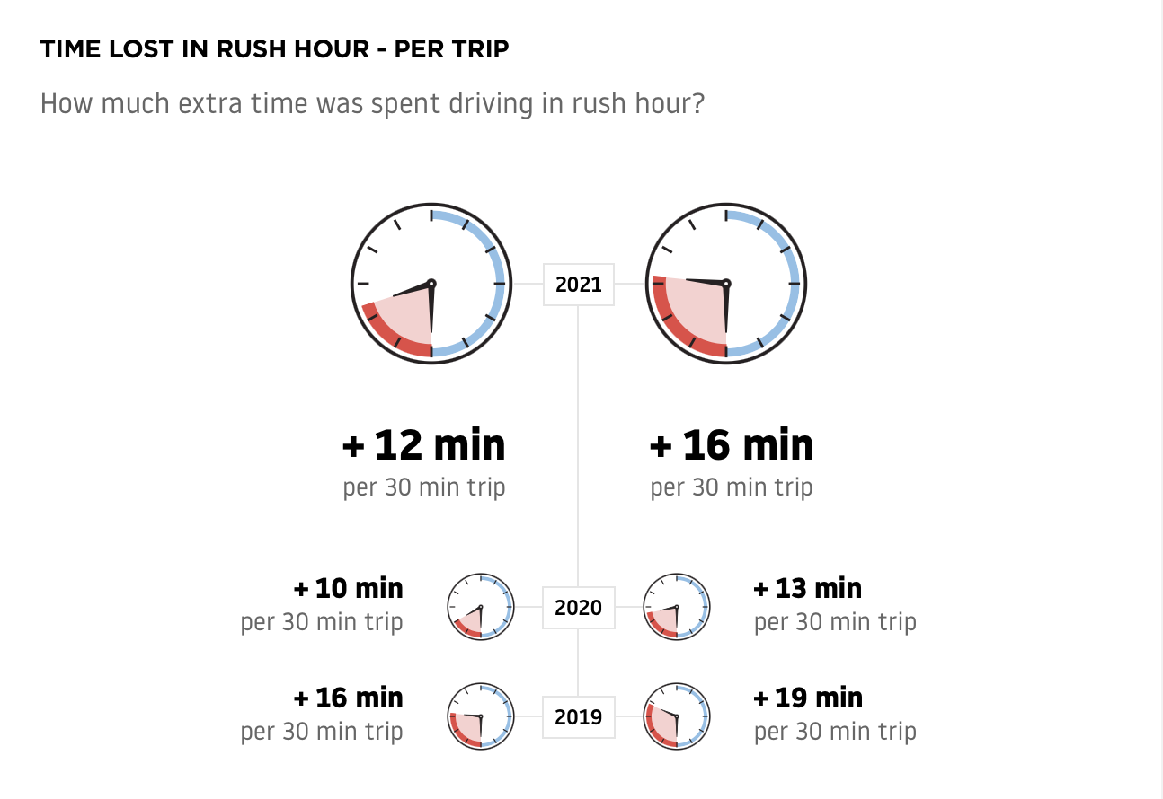
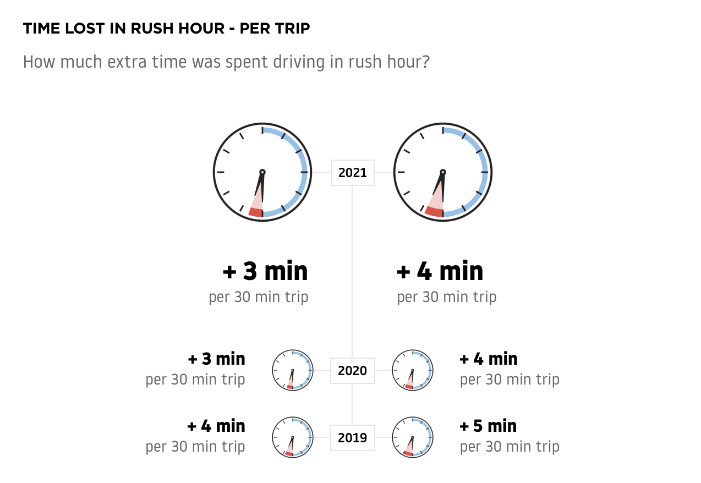
IH4: There are traffic-improving concepts used by other US cities such as Greensboro that could be applied to Miami traffic as well.
Syracuse, NY
Residents: 148,620 (2020)
Area: 26 mi²
Pop. density: ~5,716/mi²
“rising smart city star”
Miami
Residents: 461,080 (2020)
Area: 55.25 mi²
Pop. density: ~8,345/mi²
Six buckets:
use of data analytics
expanding broadband
electric vehicles
public safety
smart streetlights
smart mobility (transportation)
→ investing in infrastructure like 5G wireless and buying and installing more than 17,000 streetlights and affixing them with smart nodes
Notes:
Greensboro, NC has a population density of ~2,700 which could already explain the major difference to Miami’s traffic. However, the graphic about time lost in rush hour looks exactly the same for Greensboro and Syracuse.

Slide 20
IH5: Florida express lanes are helping to relieve Miami traffic and should be kept.
Express lanes are optional travel lanes, located on an interstate or toll road, that customers can choose to use when they want a more predictable travel time.
Effect of 95 Express during rush hour (I-95):
Before Express lane introduction :
below 20 MPH in general lanes and High Occupancy Vehicle (HOV) lanes
After Express lane introduction:
above 40 MPH in the general lanes
above 50 MPH in the express lanes
Confirm?

Slide 21
IH6: The recently built bridge connecting Hialeah and Miami Lakes helps alleviate traffic congestion.
The new bridge has opened in mid of August
It offers a second way of moving between Hialeah and Miami Lakes communities

Slide 22
Conclusion
The responsible people in Miami are aware of the bad traffic
Currently, there are ideas being implemented to improve the situation
However, these practical implementations may be too late and not extensive enough to relieve Miami traffic in the long term
→ Comparing Miami with Syracuse, the scale of the improvements need to be increased by a lot to make an impact (compare the introduction of 3,000 smart traffic lights against 17,000!)

Slide 23
Backup Sources
Images: https://thenewtropic.com/miami-traffic-gridlock-overview-planning/
https://getjerry.com/driving/how-bad-is-miami-traffic#why-is-miami-traffic-so-bad
IH1: https://doralfamilyjournal.com/smart-traffic-signals-the-new-plan-to-improve-traffic-in-miami-dade/
IH1: https://www.miamidade.gov/chambergazette/winter2020/new-smart-signals-are-cutting-commute-times.page
IH2: https://www.bizjournals.com/southflorida/news/2019/09/18/how-miami-ranks-among-best-and-worst-public.html
IH3: https://brainstation.io/magazine/4-smart-city-innovations-miami
IH4: https://www.cnbc.com/2018/07/13/wallethub-study-us-cities-with-the-best-and-worst-traffic.html
IH4: https://www.tomtom.com/traffic-index/ranking/?country=US&utm_source=newsletter&utm_medium=email&utm_campaign=newsletter_axiosam&stream=top
IH4: https://www.tomtom.com/traffic-index/miami-traffic/
IH4: https://www.goodlifecny.com/syracuse-named-one-of-8-smart-cities-to-watch/
IH5: https://www.sunpass.com/en/support/expresslanes.shtml
IH5: https://95express.com/project-overview/project-update/
IH6: https://www.nbcmiami.com/news/local/controversial-bridge-between-hialeah-miami-lakes-officially-opens/2836815/

